Slide 1
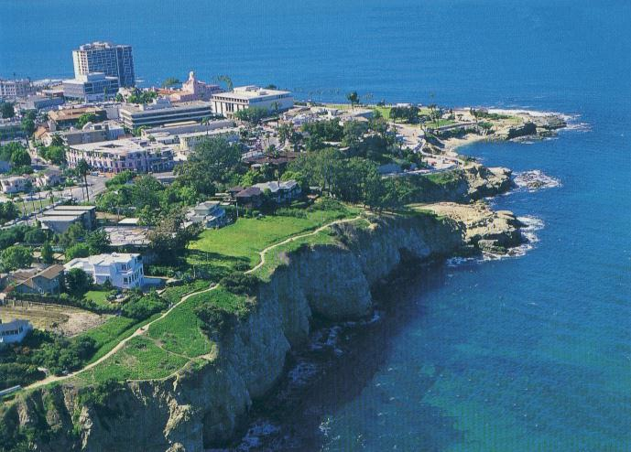
Telescience WG
PRAGMA 18
Shinji Shimojo
Fang-Pang Lin
personal.lse.ac.uk/ THIELEMA/misc.htm

Slide 2
Core Value
  Sensor network technology
  Visualization of Contents & Streaming Video
  Diversity
Opportunities for collaboration
  Sensor Network in Urban Public Infrastructure(Karpjoo, Kato)
  E-Heritage (Kadobayashi, fang-pang, Kunwon)
  Extend to Global Coral Reef Ecological Observatory Network(fang-pang, Sameer, , Joe)
  Education (Shinji, David, Fang-pang, Russel)
  Microscope (Shinji, David, Russel)

Slide 3
TDW & Visualization (day1)
  A Control Mechanism of Multiple Visualization Applications on SAGE-enabled TDW
  I-TDW: Interactive Tiled Display Wall (Masaki Chikama, Rieko Kadobayashiy, Kaori Fukunagaz and Sinji Shimojo)
  MURPA PROJECTS (Andrew Paterson, Jonathon McClure, Ben Morgan)
  Applying Marching Cubes to Silhouette Scanners (Sasha Koruga)
  Visualization and Collaboration environment for High End Applications on Virtul Reality (Kun Won Cho, et. al)
environmental monitoring (day2)
  ViewDock TDW: Rapid Visualization of Virtual Screening Results (leftover from day1)
  Update of DeveloJEO (Jeju Ecological Observatory) Cyber-Testbed
  pment of Long Term Underwater Observatories at Taiwan and Plan for New Knowledge from CREON
  Coral Virtual Site at Racha Island, Thailand
Discussion on common infrastructure, virtualized optiportal

Slide 4
Charges
What are the problems ?
What can we do to solve those problems collaboratively ?
Let us make visualization collaboratories
  networking of HD, 2D, 3D and more.
If we could find a solution, let us show it in next occasion like PRAGMA 19 or SC10.
get greener

Slide 5
Survey
Sensor network/Urban Monitoring 9
Tiled Display Wall 7
Cave/StarCAVE 2
Cultural Heritage 4

Slide 6
Remote presentation using sage even you don’t have a TDW.
exchange experience of SAGE and CGLX, COVICE
Large scale visualization platform PICASSO by KISTI
Joint Celebration events for Nara 1300 anniversary in Cyberinfrastructure
Monitoring using Dataturbine

